Slide 1
Chapter 8: Subnetting IP networks
Introduction to Networks v5.1

Slide 2
Section 8.1: Subnetting an IPv4 Network
Upon completion of this section, you should be able to:
Explain how subnetting segments a network to enable better communication.
Explain how to calculate IPv4 subnets for a /24 prefix.
Explain how to calculate IPv4 subnets for a /16 and /8 prefix.
Given a set of requirements for subnetting, implement an IPv4 addressing scheme.
Explain how to create a flexible addressing scheme using variable length subnet masking (VLSM).

Slide 3
Topic 8.1.1: Network Segmentation

Slide 4
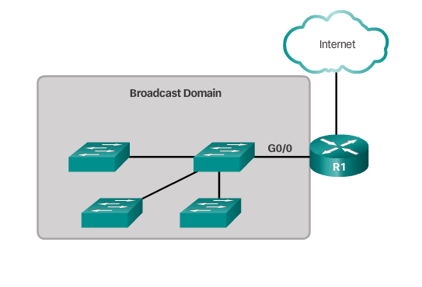
Broadcast Domains
Each router interface connects a broadcast domain and broadcasts are only propagated within its specific broadcast domain.
Notes:
8.1.1.1 Broadcast Domains

Slide 5
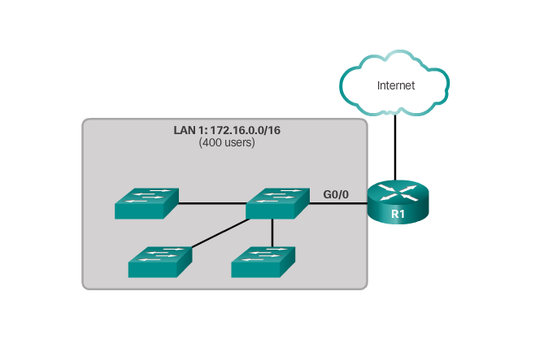
Problems with Large Broadcast Domains
Slow network operations due to the significant amount of broadcast traffic.
Slow device operations because a device must accept and process each broadcast packet.
Notes:
8.1.1.2 Problems with Large Broadcast Domains

Slide 6
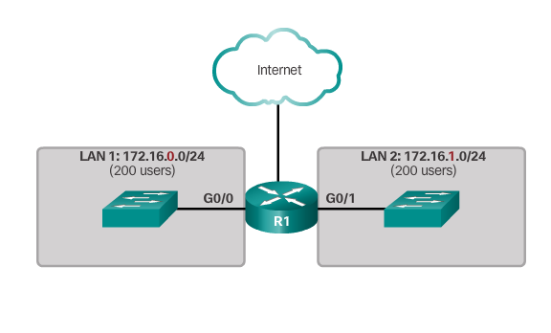
Problems with Large Broadcast Domains (cont.)
Solution -reduce the size of the network to create smaller broadcast domains in a process called subnetting.
These smaller network spaces are called subnets.
Notes:
8.1.1.2 Problems with Large Broadcast Domains (Cont.)

Slide 7
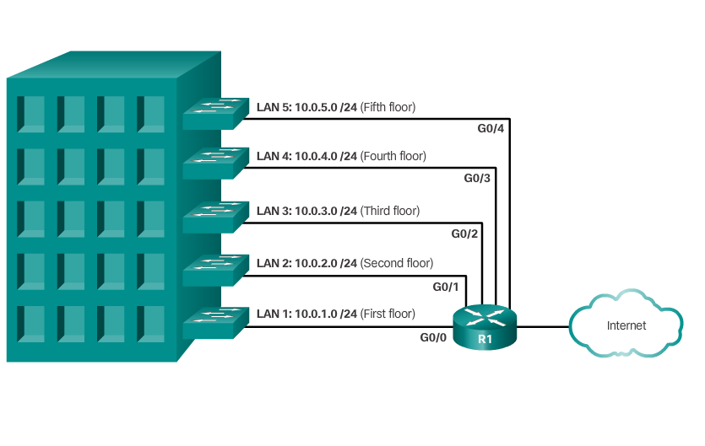
Reasons for Subnetting
Network administrators can group devices and services into subnets that are determined by: Location
Notes:
8.1.1.3 Reasons for Subnetting

Slide 8
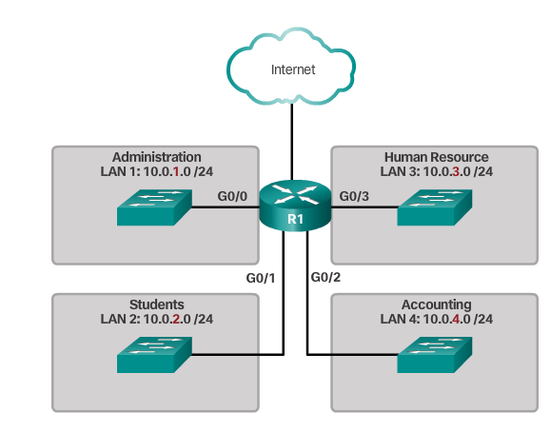
Reasons for Subnetting (cont.)
Network administrators can group devices and services into subnets that are determined by: Organizational unit.
Notes:
8.1.1.3 Reasons for Subnetting (Cont.)

Slide 9
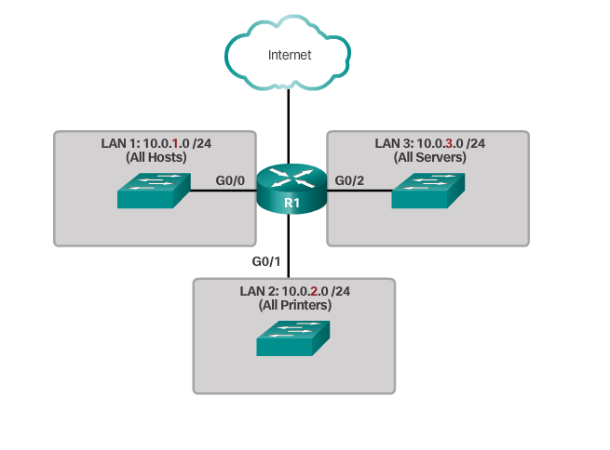
Reasons for Subnetting (cont.)
Network administrators can group devices and services into subnets that are determined by: Device type.
Notes:
8.1.1.3 Reasons for Subnetting (Cont.)

Slide 10
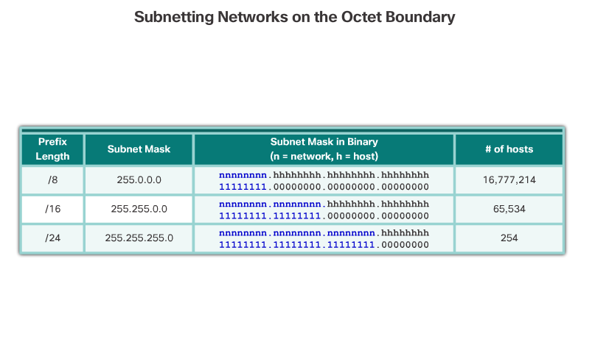
Octet Boundaries
Notes:
8.1.2.1 Octet Boundaries

Slide 11
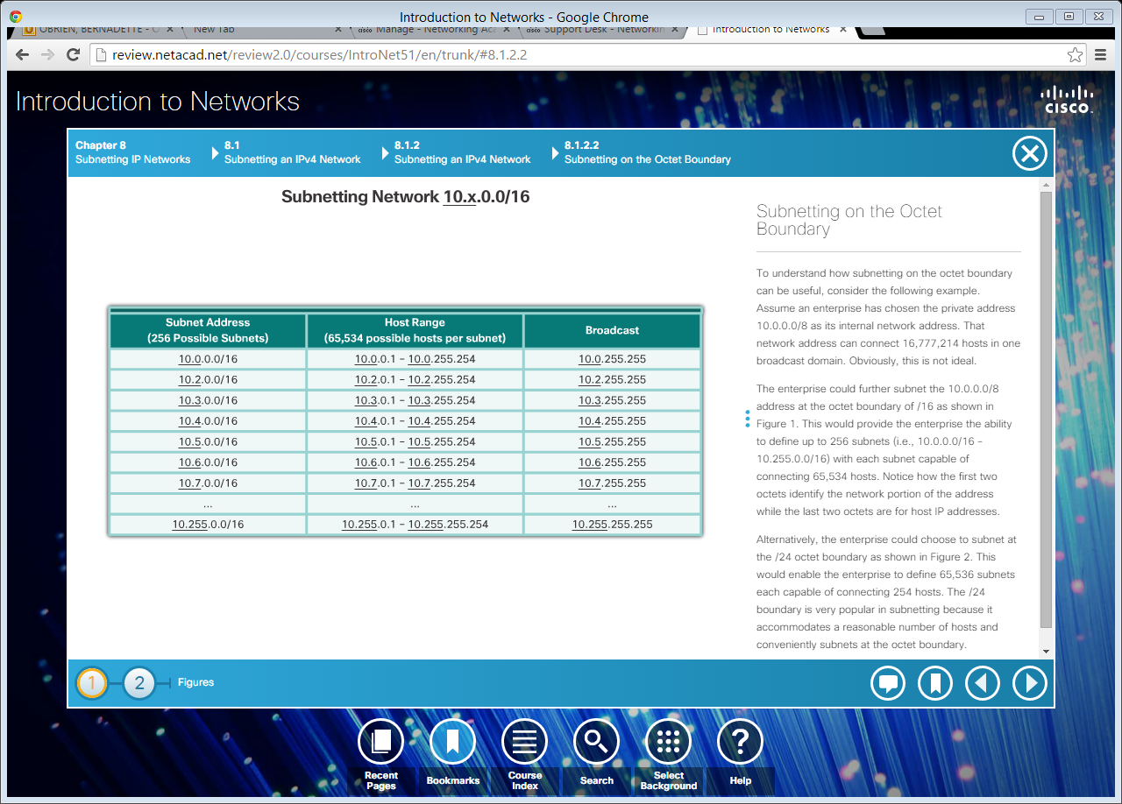
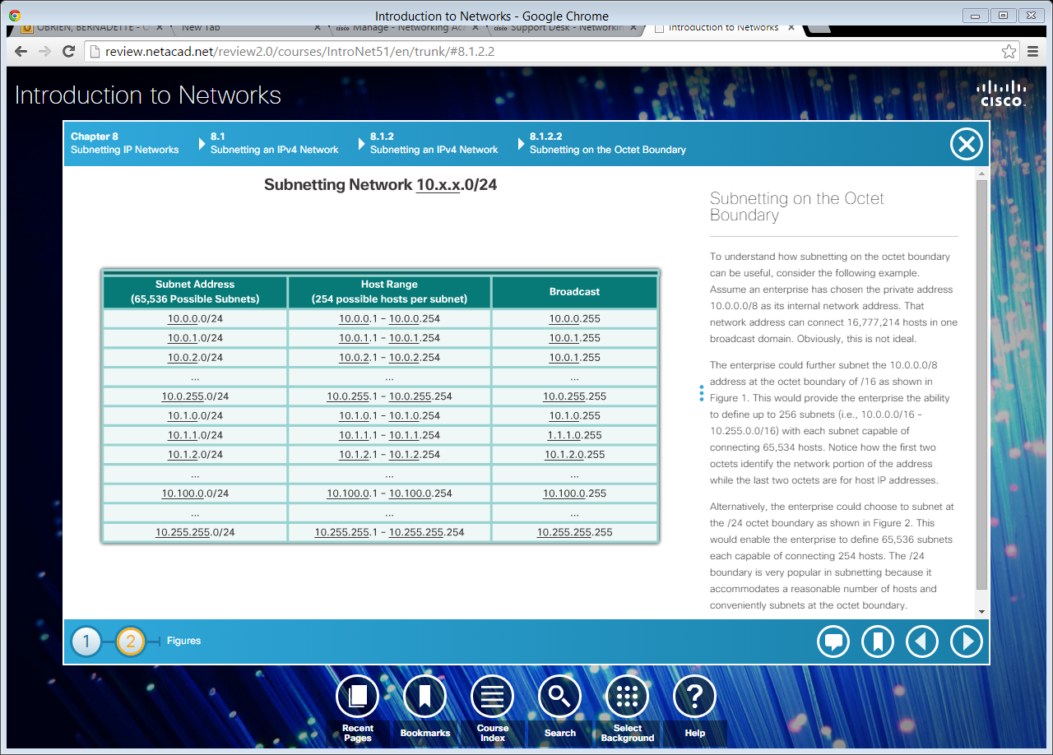
Subnetting on the Octet Boundary
Subnetting 10.x.0.0/16
Subnetting 10.x.x.0/24
Notes:
8.1.2.2 Subnetting on the Octet Boundary

Slide 12
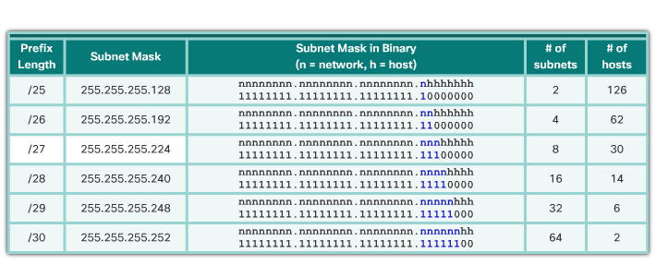
Classless Subnetting
/25 – Borrowing 1 bit from the fourth octet creates 2 subnets supporting 126 hosts each.
/26 – Borrowing 2 bits creates 4 subnets supporting 62 hosts each.
/27– Borrowing 3 bits creates 8 subnets supporting 30 hosts each.
/28 – Borrowing 4 bits creates 16 subnets supporting 14 hosts each.
/29 – Borrowing 5 bits creates 32 subnets supporting 6 hosts each.
/30– Borrowing 6 bits creates 64 subnets supporting 2 hosts each.
Notes:
8.1.2.3 Classless Subnetting
8.1.2.4 Video Demonstration – The Subnet Mask
8.1.2.5 Video Demonstration – Subnetting with the Magic Number

Slide 13
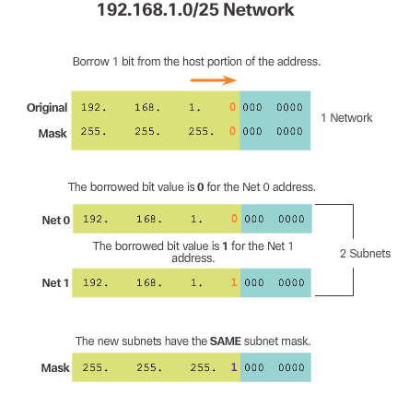
Classless Subnetting Example
Notes:
8.1.2.6 Classless Subnetting Example

Slide 14
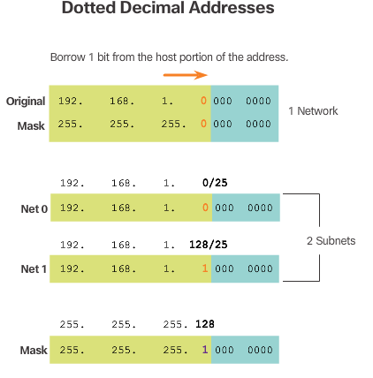
Classless Subnetting Example (cont.)
Notes:
8.1.2.6 Classless Subnetting Example (Cont.)

Slide 15
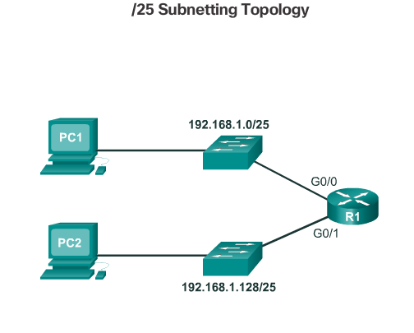
Creating 2 Subnets
Notes:
8.1.2.7 Creating 2 Subnets

Slide 16
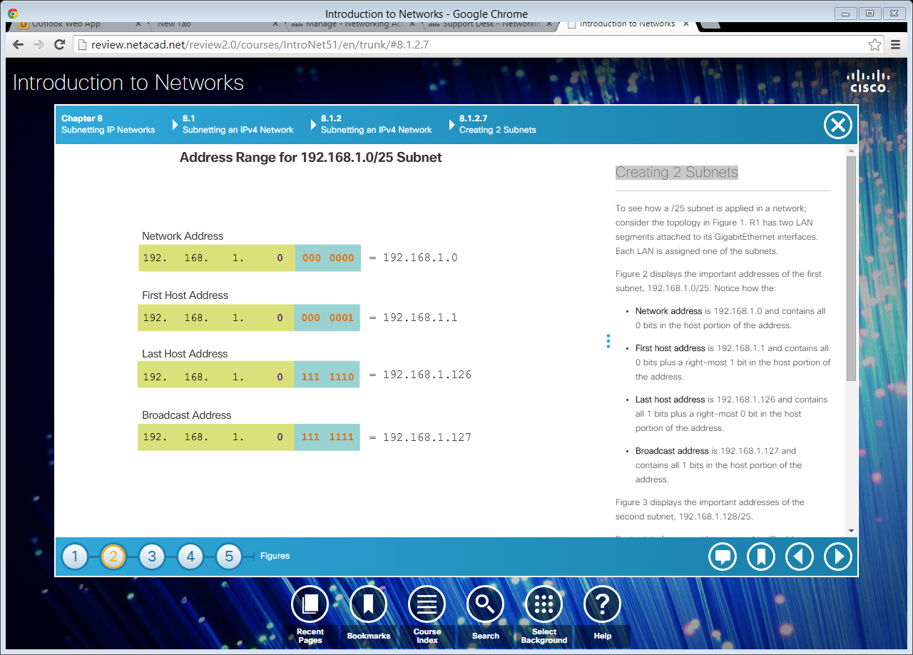

Creating 2 Subnets (cont.)
Notes:
8.1.2.7 Creating 2 Subnets (Cont.)

Slide 17
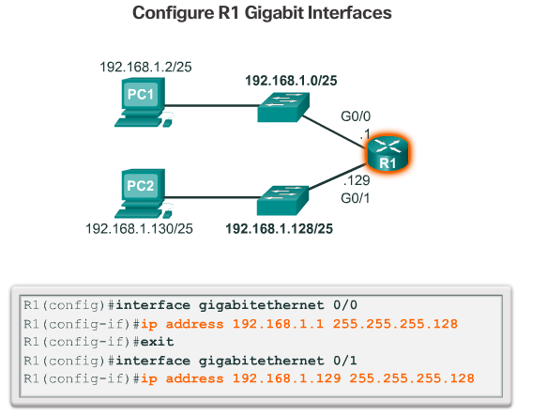
Creating 2 Subnets (cont.)
Notes:
8.1.2.7 Creating 2 Subnets (Cont.)

Slide 18
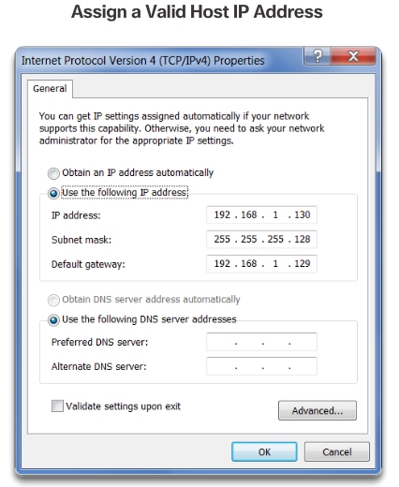
Creating 2 Subnets (cont.)
Notes:
8.1.2.7 Creating 2 Subnets (Cont.)
8.1.2.8 Video Demonstration – Creating Two Equal-Sized Subnets

Slide 19
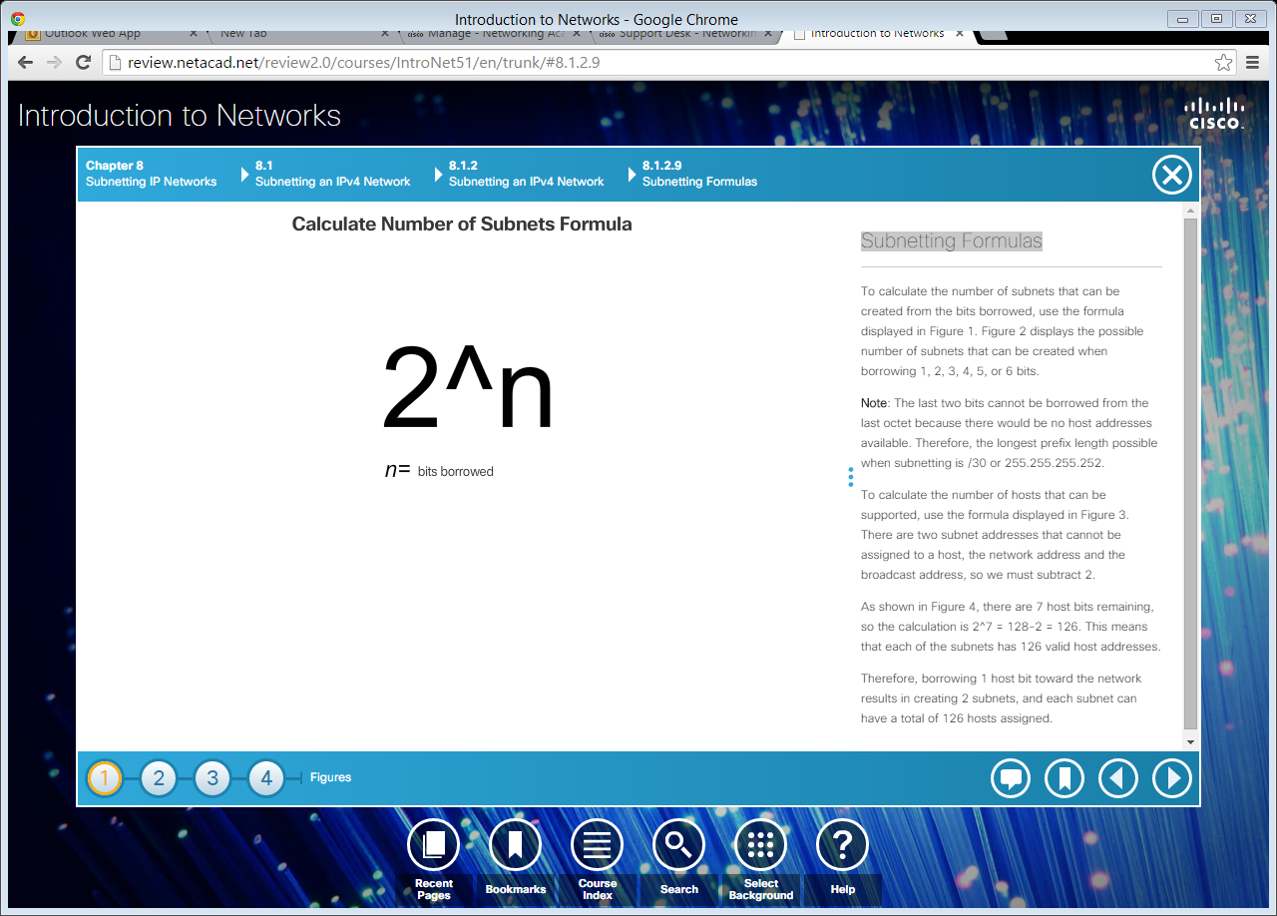
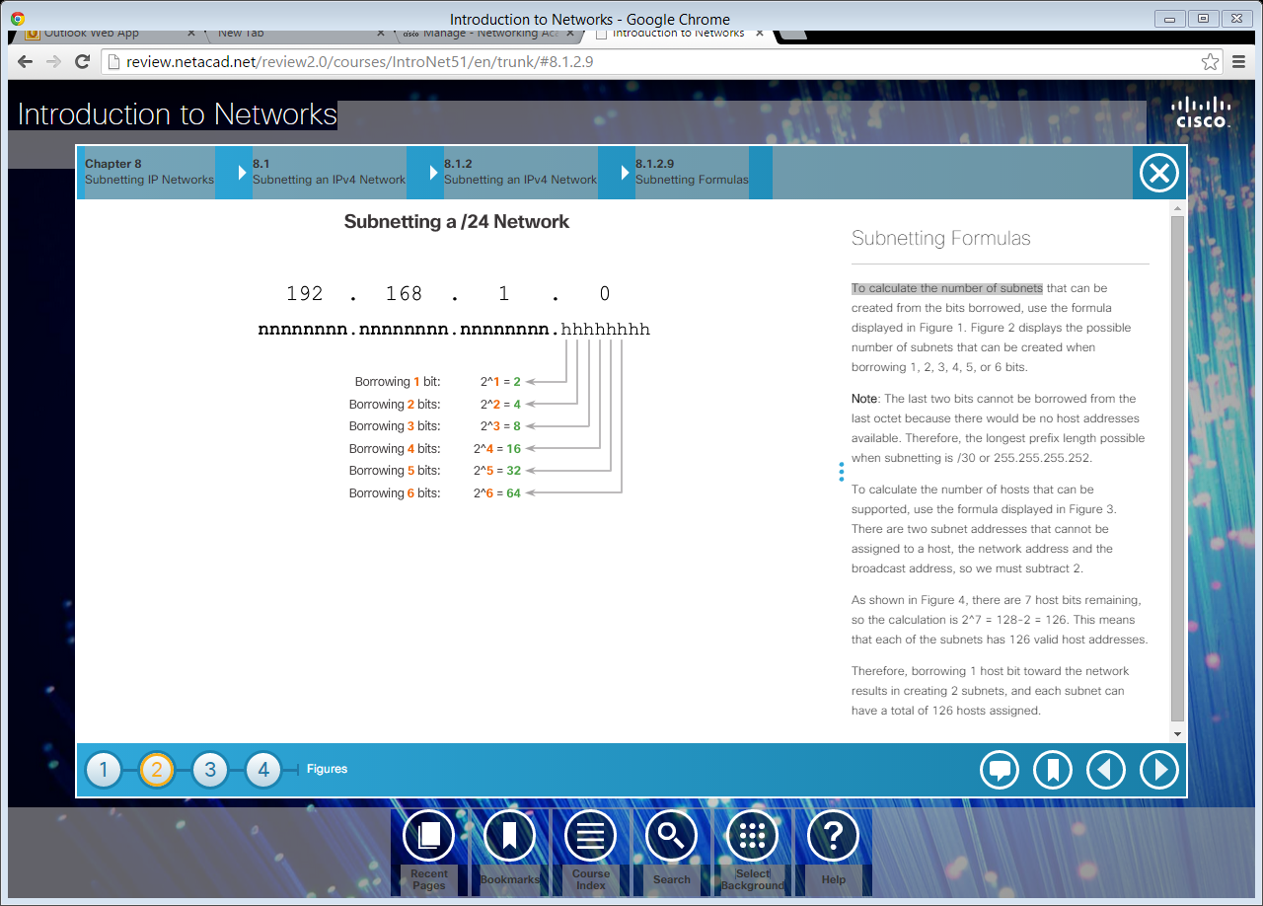
Subnetting Formulas
To calculate the number of subnets.
Notes:
8.1.2.9 Subnetting Formulas

Slide 20
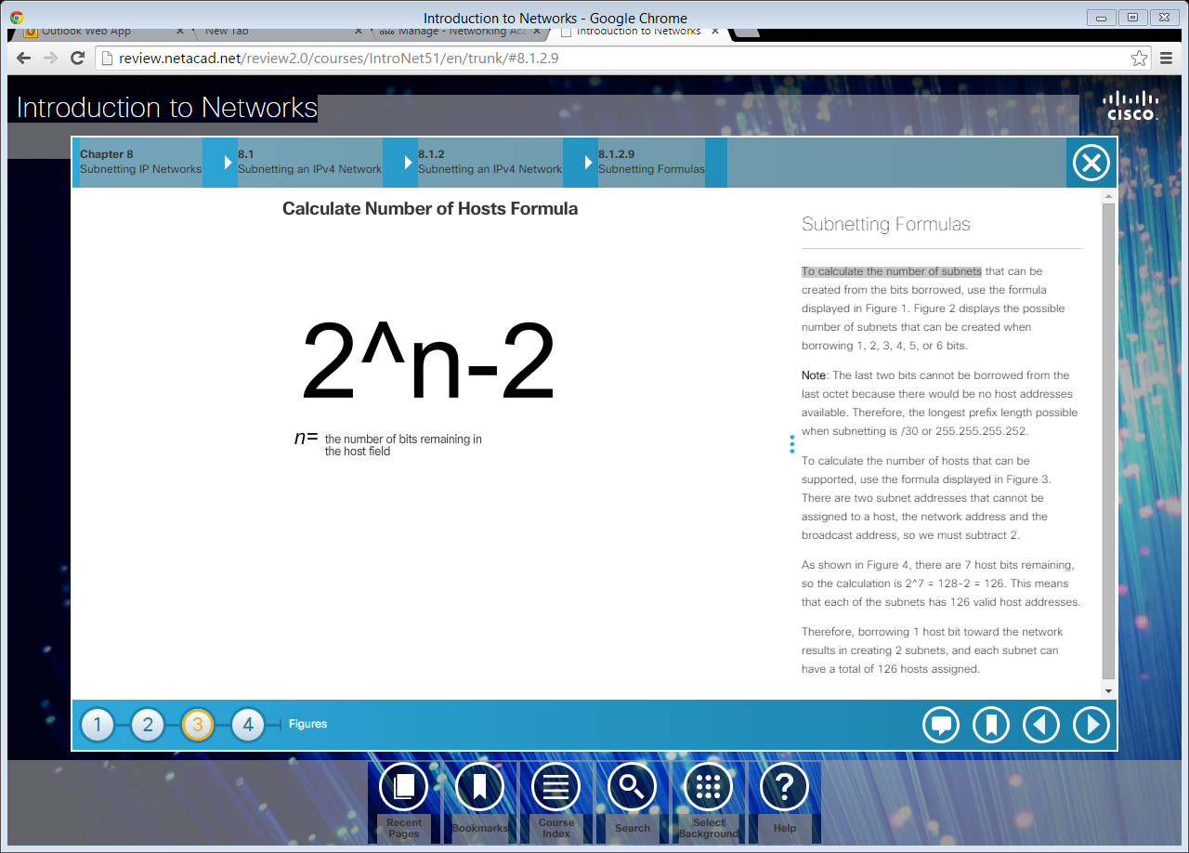
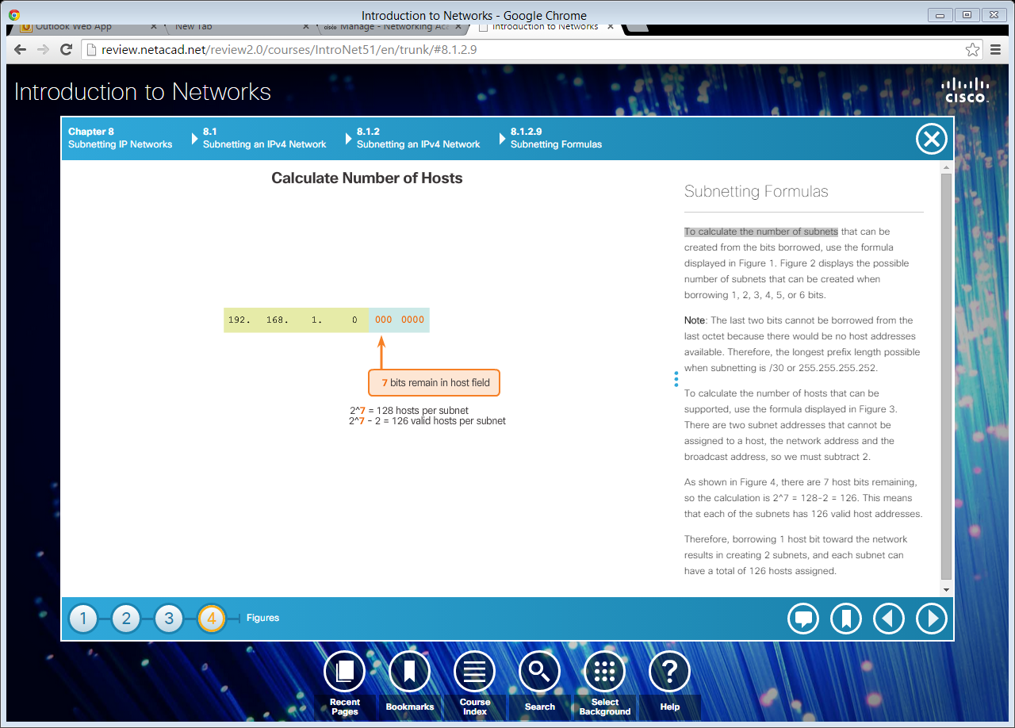
Subnetting Formulas (cont.)
To calculate the number of hosts.
Notes:
8.1.2.9 Subnetting Formulas (Cont.)

